Slide 1
Year 1 English

Slide 2
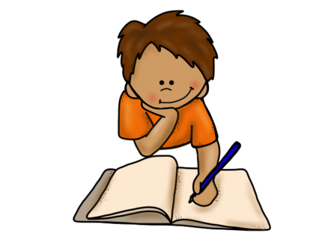
Little Red Riding Hood
Read the story of Little Red Riding Hood then complete the activities that come afterwards. You have sheets in your home learning pack for these activities.

Slide 3
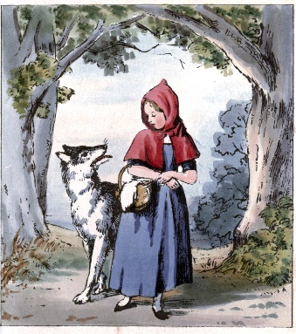
Little Red Riding Hood
Once upon a time there was a girl called Little Red Riding Hood. One day, her mother gave her a basket of food to take to her sick Granny.
As Little Red Riding Hood walked through the forest, a wolf watched her from behind the trees and he ran ahead to Granny’s cottage.
When the wolf got to the cottage, he popped Granny in the bin! Then he put on her night-dress and jumped into bed.

Slide 4
A little later, Little Red Riding Hood came to the cottage. She knocked on the door, then went inside…
Little Red Riding Hood went over to Granny’s bed. “Oh Granny, what big ears you have,” she said. “All the better to hear you with,” answered the wolf.
“Oh Granny, what big eyes you have,” said Little Red Riding Hood. “All the better to see you with,” replied the wolf.
“Oh Granny, what big teeth you have,” said Little Red Riding Hood. “All the better to eat you with,” said the wolf.

Slide 5
“Help!” shouted Little Red Riding Hood as she realised that there was a wolf in her Granny’s bed. She ran out of the house.
A woodcutter was nearby. He heard Little Red Riding Hood’s scream and ran to the house.
The woodcutter hit the wolf over the head and rescued Granny from the bin. The wolf ran away and Little Red Riding Hood never saw him again.
The End

Slide 6
Activity 1
Beginning, middle and end.
Can you write what happens at the beginning, middle and end of the story in your own words? Use these words to start each part:
Once upon a time
Next
Then

Slide 7
Activity 2
Setting description
The story of Little Red Riding Hood is set in a forest. Can you look at the forest picture on your sheet and describe it using interesting adjectives? Think about what you would see, hear, feel, smell and taste.
Here is an example:
I can see the huge trees swaying from side to side.

Slide 8
Activity 3
Character description
The wolf is the ‘baddie’ in the story. How would you describe him? Try to use interesting adjectives to say what he looks like and what his personality is like.
Here is an example:
The wolf has dark beady eyes.

Slide 9
Activity 4
Speech
Sometimes we don’t find out what a character is saying in a story. What do you think these characters could be saying?
Remember, you can use exclamation marks at the end of the sentence if they are shouting or saying something funny or mean!

Slide 10
Activity 5
A Kind Wolf
Imagine the wolf is not unkind when he visits Granny’s cottage. What might he and Granny do instead? Write about it using full sentences.
Do they have a tea party?
Do they play a game in the garden?

Slide 11
The Way Back Home
Listen to the story, The Way Back Home, then complete the activities that come afterwards. You have sheets in your home learning pack for these activities.
To hear the story click here: https://www.youtube.com/watch?v=RbyUrb0X5iU

Slide 12
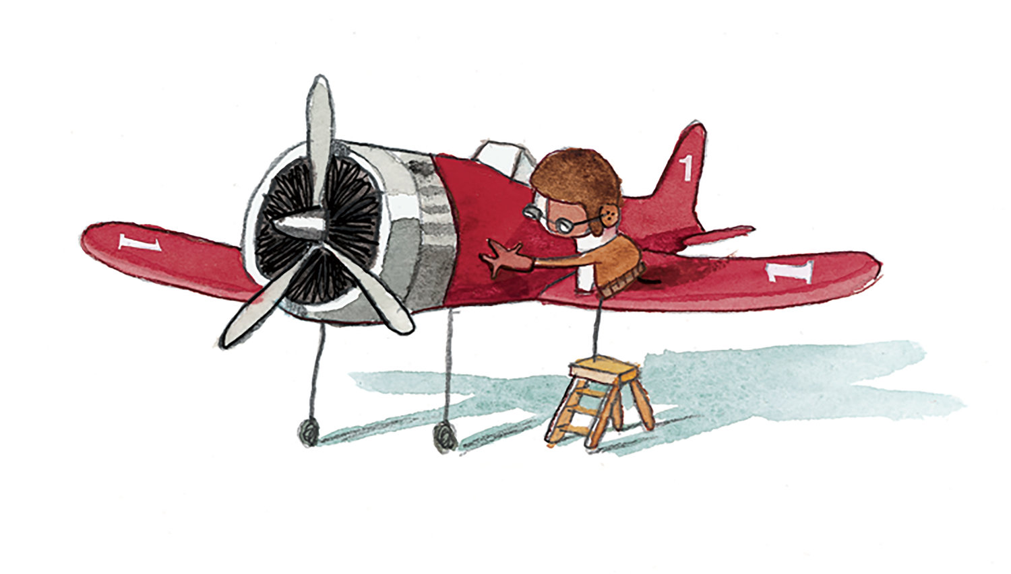
Activity 1
In the story the boy finds an aeroplane in his cupboard. Imagine you find an aeroplane. What would you do with it? What sort of adventure would you go on? Would you go into space?

Slide 13
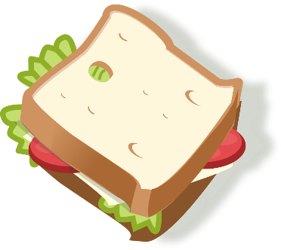
Activity 2
The boy wants to take a sandwich to the alien on the moon but he doesn’t know how to make one. Can you write him some instructions to make your favourite sandwich?
Remember to use bossy verbs like put, spread, chop, cut.
Try starting your sentences with the words first, next, then, finally.

Slide 14
Activity 3
The alien decides to come to Earth to visit the boy for an adventure. What do they get up to? Write your own story about it. Here are some ideas to help your imagination!
Do they go to the beach? Do they go to the jungle? Do they have a delicious meal? Do they meet anyone else?
Don’t forget to say your sentences in your head and out loud before you write them down!

Slide 15
Activity 4
Can you tell the story The Way back Home to someone in your house? Then can you write it down in your own words?
Try to use the words first, next, then and finally in your story.
Don’t forget to start your sentences with a capital letter and finish them with a full stop or an exclamation mark.

Slide 16
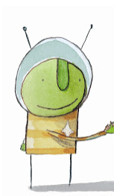
Activity 5
The alien is one of the characters in the story but we don’t know everything about him. Can you use your imagination to tell us all about the alien?

Slide 17
Literacy learning ideas
Here are some activities and games that you could try doing at home to support your child in their literacy development.
Read and retell favourite stories
I spy game
Find words that rhyme
Sing songs and nursery rhymes
Go on an alphabet hunt collecting items that start with each letter
Follow simple recipes

