Slide 1
Year 2 - English
The Snail and The Whale
By Julia Donaldson

Slide 2
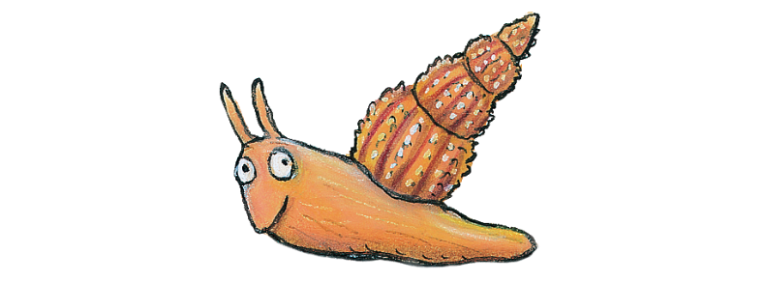
Click here to listen to the story or turn to the next page to read the story.
Also, there is an animated version of the story here if you would like to watch it another time ☺

Slide 3
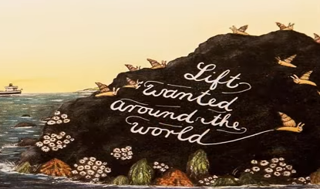
This is a tale of a tiny snail and a great, big grey-blue humpback whale.
This is a rock as black as soot
And this is a snail with an itchy foot.
The sea snail slithered all over the sock
And gazed at the see and the shape of the dock
And as the gazed she sniffed and sighed
“The sea is deep and the world is wide!
How I long to sail” said the tiny snail.
These are the other snails in the flock,
Who all stuck tight to the smooth black rock
And said to the snail with the itchy foot
“Be quiet! Don’t wiggle! Sit still! Stay put!”
But the tiny sea snail sighed and sniffed
Then cried “I’ve got it! I’ll hitch a lift!”
This is the trail of the tiny snail
A silvery trail that lopped and curled and said..
This is the whale that came one night,
When the tide was high and the stars were bright.
A humpback whale, immensely long,
Who sang to the snail a wonderful song
Of shimmering ice and cold caves
And shooting stars and enormous waves
And this is the tale of the humpback whale
He held it out of the starlet sea and said to the snail…

Slide 4
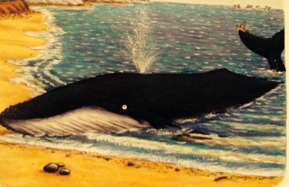
“Come sail with me”.
This is the sea, so wild and free
That carried the whale and the snail on his tail,
To taring icebergs and far off lands.
With fiery mountains and golden sands.
These are the waves that arched and crashed,
That foamed and frolicked and sprayed and splashed
The tiny snail on the tail of the whale.
These are the caves beneath the waves,
Where stripy fish with feathery fins
And sharks with hideous toothy grins
Swam around the whale and the snail on his tail.
This is the sky, so vast and high.
Sometimes sunny and blue and warm,
Sometimes filled with thunderstorm.
With zigzag lightning, flashing and frightening
The tiny snail on the tail of the whale.
And she gazed at the sky, the sea, the land.
The waves and the caves and the golden sand,
She gazed and gazed, amazed by it all
And she said to the whale, “I feel so small”.
But then came the day, the whale lost its way.
These are the speedboats running a race.
Zigging and zooming all over the place.
Upsetting the whale with their ear-splitting roar,
Making him swim to close to the shore.
This is the tide, slipping away

Slide 5
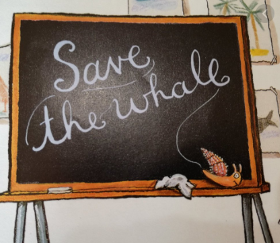
And this is the whale lying beached in a bay.
“Quick! Off the sand” Back to sea!” cried the snail.
“I can’t move on land! I’m too big!” moaned the whale.
The snail felt helpless and terribly small
Then “I’ve got it!” she cried and started to crawl.
“I must not fail” said the tiny snail.
This is the bell on the school in the bay,
Ringing the children in from their play.
This is the teacher, holding her chalk.
Telling the class “Sit straight! Don’t talk!”
This is the board, as black as soot,
And this is the snail with the itchy foot!
“A snail! A snail!” the teacher turns pale.
“Look!” say the children, “it’s leaving a trail”
This is the trail, of the tiny snail,
A silvery trail saying…..
These are the children, running from school,
Fetching the firemen, digging a pool.
Squirting and spraying to keep the whale cool.
This is the ride coming into the bay,
And these are the villagers shouting “hurray!”
As the whale and the snail travel safely away.

Slide 6
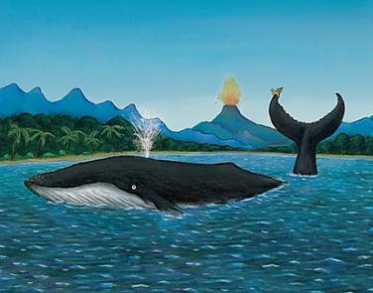
Back to the dock, and the flock on the rock,
Who said “how times flown!”
And “haven’t you grown!”
And the whale and the snail, told their wonderful tale
Or shimmering ice and coral caves
And shooting stars and enormous waves.
And of how the snail, so small and frail
With her looping, curling, silvery train,
Saved the life of the humpback whale.
Then the humpback whale
Held out his tail,
And on crawled snail after snail after snail.
And they sang to the sea as they all set sail
On the tail of the grey-blue humpback whale.

Slide 7
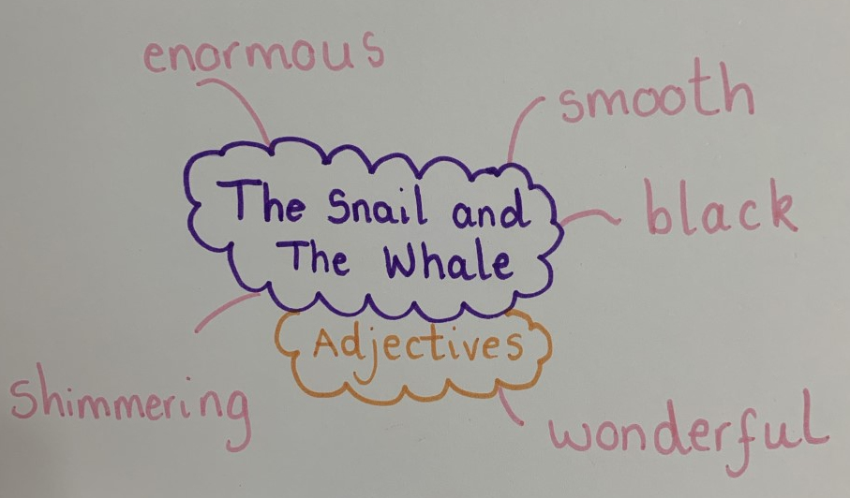
Task 1 – Identifying adjectives Use blank paper for this task.
Remember – an adjective is a describing word!
I hope you enjoyed The Snail and The Whale! I know I did. The story has lots of adjectives in. Can you spot them all and make your own poster displaying them? Take a look at mine below.
I wonder how many adjectives you can find!
Extension: Can you sort the adjectives? Which adjectives have the same suffixes? –ing, -full

Slide 8
Task 2 – Identifying similes Use template 6 for this task
A rock is described as being ‘as black as soot’. This is a simile. A simile is when you compare one thing to something else.
A simile uses the words ‘like’ or ‘as’ such as;
As big as an elephant
As brave as a lion
As busy as a bee
They fight like cats and dogs.
She swims like a fish.
Oh, you sing like an angel.
Click here for a song on similes.
Can you find all the similes in the book ‘The Snail and The Whale”?
Once you have found them, can you write your own similes?
Use template 5 for this task.

Slide 9
Task 3 – Using adjectives Use template 7 for this task.
You have had lots of practice identifying adjectives. We are now going to use adjectives in our own writing. On template 5, there is a picture from the book ‘The Snail and The Whale’. Can you describe the setting?
A blue and red parrot sits peacefully on a black and bumpy rock.
I wonder if you could use similes to describe the setting too for example –
The trees were as green as grass swaying in the wind.
You must:
Write in full sentences using capital letters and full stops.
Use adjectives to describe the scene.
You should:
Use similes to make your writing more interesting.
You could:
- Use conjunctions such as because, and to extend sentences where possible.

Slide 10
Task 4 – Write a postcard. Use template 8 for this task.
I bet the snail had so much fun on his adventure with the whale.
You are going to pretend the snail has been on another adventure in the ocean with a different animal. What other animal could the snail ride on and where could it go?
Write the postcard to your other snail friends.
Other animals in the ocean – sharks, dolphins, seals, sea turtles. or maybe think of your own.
You must:
Write in full sentences using capital letters and full stops.
Write in the first person using the pronoun I.
You should:
Use adjectives to describe what you noticed.
Extend sentences using conjunctions
You could:
- Use conjunctions such as because, and to extend sentences where possible.

Slide 11
Task 5 - Phonics
Read this passage. Find the sounds and verbally complete the sentences.
The first one has been done for you.
I found..
The a-e sound in whale.
The ou sound in ______.
The ea sound in ______.
The ai sound in ______.
The ly sound in ______.
The ar sound in ______.
The ing sound in ______.
The o-e sound in ______.
The i-e sound in ______.
This is the whale who came one night
When the tide was high and the stars were bright.
A humpback whale, immensely long
Who sang to the snail a wonderful song
Of shimmering ice and coral caves
And shooting stars and enormous waves.
And this is the tail
Of the humpback whale
He held it out of the starlit sea,
And said to the snail
“Come sail with me”

Slide 12
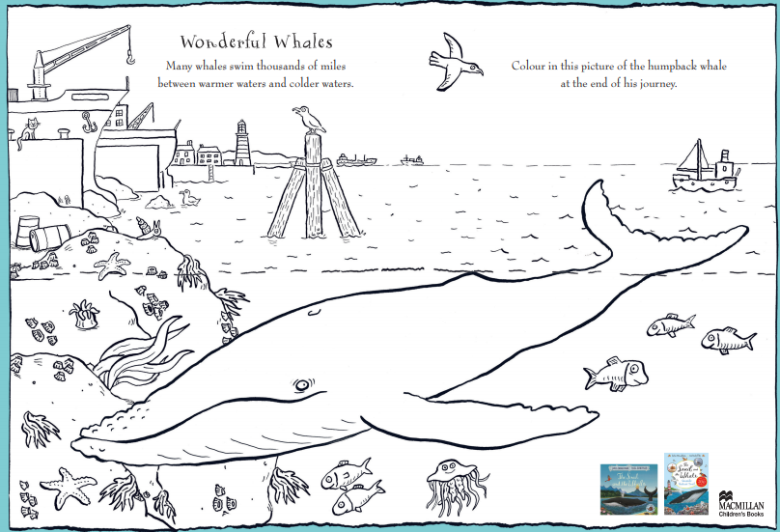
You don’t have to do this but I have sent home this The Whale and The Snail colouring sheet for you to enjoy. Missing you all. Stay safe Love Miss Cresswell x

