Slide 1
Year 1 English
Thursday 7th January 2021

Slide 2
Busy picture warm up
Look at the picture on the next page. What can you see? Say out loud what you can see, just like we do in class. Try to make your sentence really interesting. Here is my sentence:
There is a little girl wearing a pink dress.

Slide 3
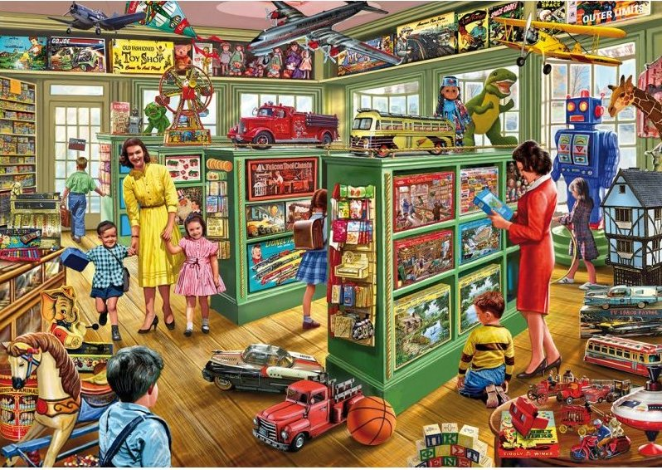

Slide 4
We’re Going on a Picnic by Pat Hutchins
Follow this link to listen to the story again:
https://www.youtube.com/watch?v=W_-JOreALIg
What would you take on a picnic?

Slide 5
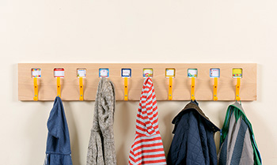
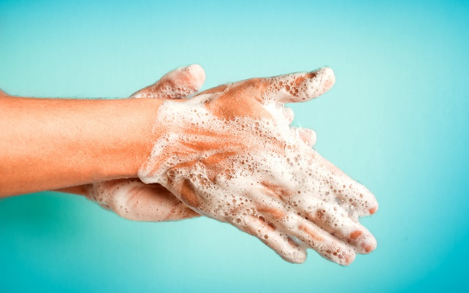
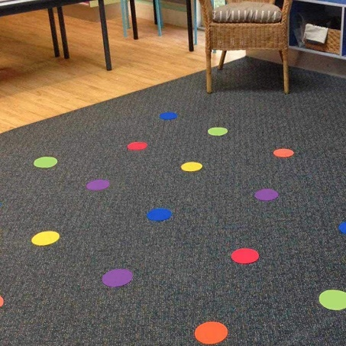
Yesterday we wrote instructions for brushing our teeth. Today we will think about our routine when we come into class on a morning.
What do we do first with our coat and bag?
Then what do we do?
After that what do we do?
Use the pictures to help say your sentences in the right order.

Slide 6
Your writing task
On the sheet in your pack can you draw a picture for each part of our morning routine? Then write a sentence to say what we do. Your first sentence could be:
First, hang your coat and bag on your peg.
Remember to start your sentences with a big capital letter and finish them with a full stop.

Slide 7
Literacy learning ideas
Here are some activities and games that you could try doing at home to support your child in their literacy development.
Read and retell favourite stories
I spy game
Find words that rhyme
Sing songs and nursery rhymes
Go on an alphabet hunt collecting items that start with each letter
Follow simple recipes

