Slide 1
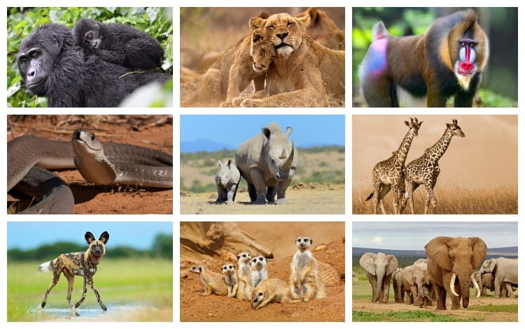
Year 2 Science and Topic

Slide 2
Topic
Can you remember where the book ‘The Ugly Five’ is set? That’s right – Africa! In the African Savanna to be exact. Do you know where Africa is? Do you think Africa is similar or different to where we live? Why?
Click here to watch a video all about Africa.
What facts can you remember? Look on the next page for some of the facts in the video. They are fascinating! How many more can you add to my list?

Slide 3
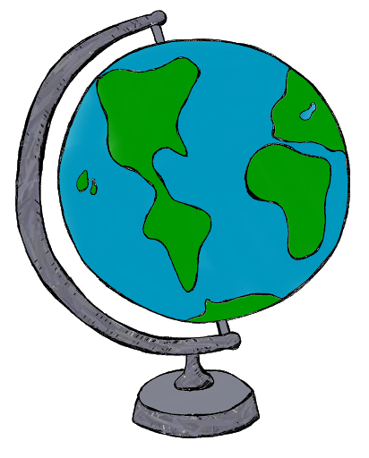
Africa is home to the largest dessert in the world. It is called the Sahara Dessert.
Africa is the hottest continent in the world.
Africa has the second largest rainforest in the world called The Conga Rainforest.
Africa is the hottest continent in the world.
Herbivores are known as plant eaters and there is lots of them in the Savanna.
Herbivores live in groups to help protect them from predators.

Slide 4
Topic
Take a look at the map of the world in the next page.
Can you find the United Kingdom (UK) where we live?
Can you find Africa?
How could you travel from the UK to Africa?
What transport could you use?
Can you find all the oceans?
Which is the closest ocean to Africa?
Which is the closest ocean to the UK?
Look at the worksheet I have printed off. Label the five oceans.

Slide 5
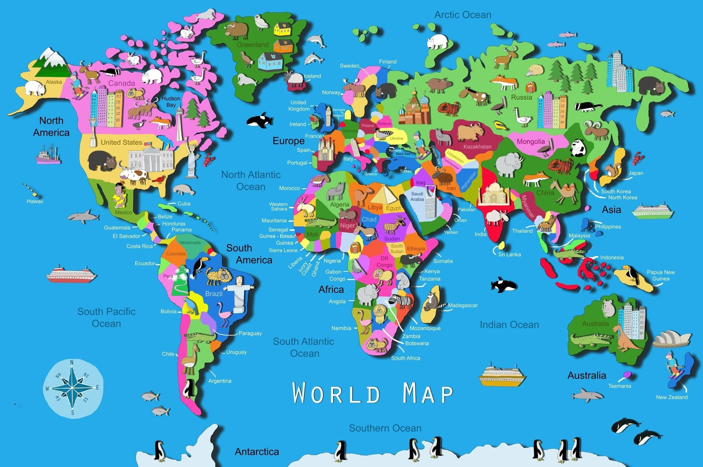

Slide 6
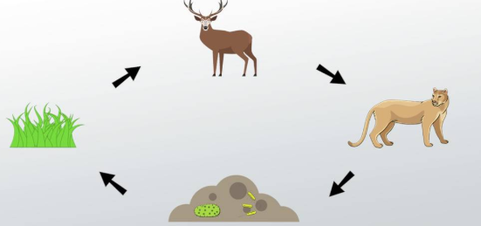
Science
We have been looking at animals in large habitats while reading the books ‘The Ugly Five and ‘The Snail and The Whale’.
(Although, the snail wasn’t in his usual habitat!)
Why do you think these living things live here? They live there because there is plenty of food and nutrients for them there.
A plant in Africa has lots of sunlight.
A zebra has lots of plants to eat.
A lion has lots of zebras to eat.
A full lion poops a lot! This feeds the plants.
This is called a food chain.
An example food chain
herbivore.
producer.
carnivore.
waste = nutrients
Click here to watch a video on food chains.

Slide 7
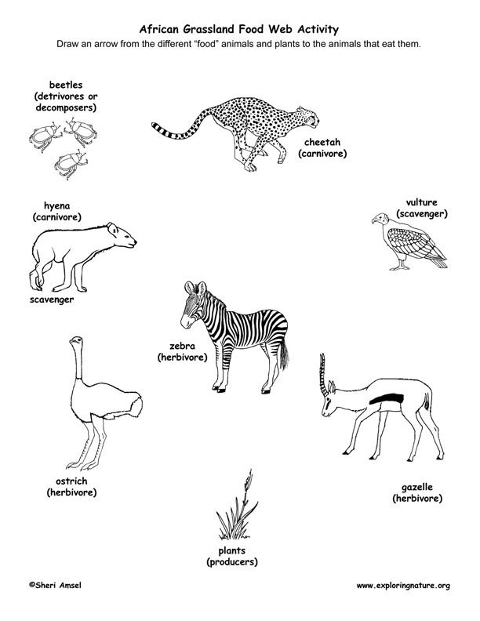
Science
Look at this picture.
Which animal eats what?
Remember –
A plant is a producer.
A herbivore eats plants.
A carnivore eats meat.
An omnivore eats both plants and meat.
A scavenger eats waste.

Slide 8
Science/Art
In science, we have been looking lots at different habitats. Look back on the world map. What animals are there in Africa?
Can you draw a picture of the African Savanna and some animals that might live there. Think about their habitat and food chains. What food might be around for them to eat?
Think back to ‘The Ugly Five’ – that is a good place to start!

