Slide 1
The shopping basket
Reception class

Slide 2
Click on the picture below to listen to the story.

Slide 3
Stephen went to the shops. To help him remember what he needed to buy he could have made a shopping list. A list is where we put the words underneath each other, not in a line next to each other, like this: Shopping list peas carrots chips pizza
Activity:
Listen again to the story and write a shopping list for Stephen using the sheet from the pack. Think about your sounds and how you can write those. You can draw numbers for the amount of things he needs to buy.
Make sure you put your words underneath each other so that it looks like a list.

Slide 4
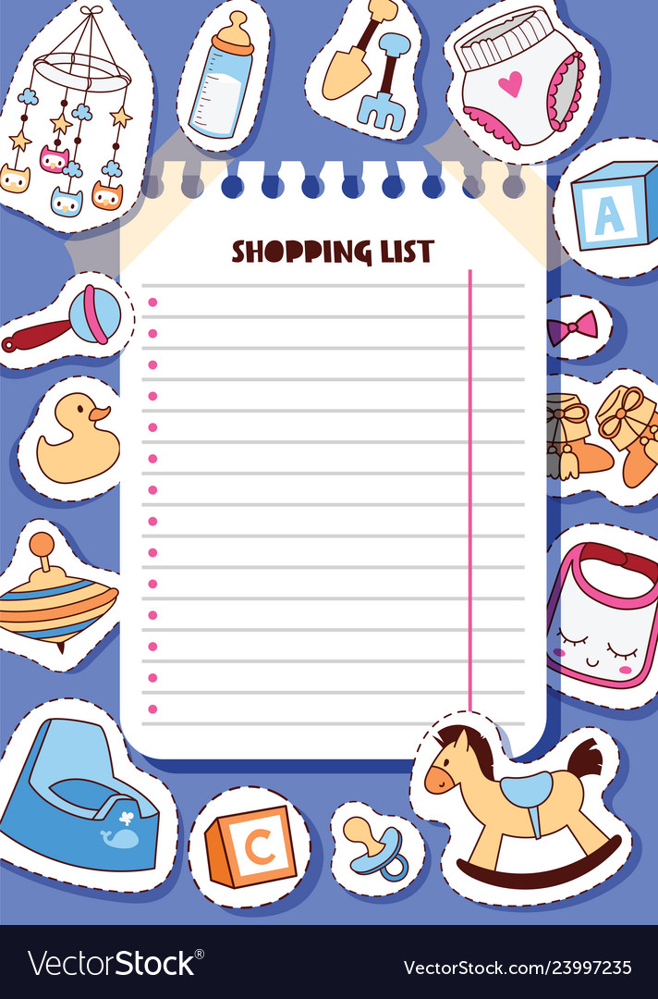
Activity: I would like you to think about a different list you might like to make. It could be a shopping list for when you go shopping to the supermarket, or it could be a different kind of list. It could be a list of the things you would like to buy from a toy shop, or a list of things you would have to buy for a baby… it can be your special list….
Remember to write the things underneath each other so it looks like a list.
Sometimes in a list we put dots next to each new thing or numbers.
Use the sheet in the pack to make your special list. You can decorate it if you would like to by drawing some of the things you put on it around the outside.

Slide 5
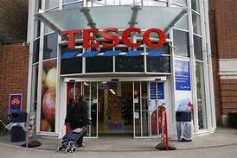
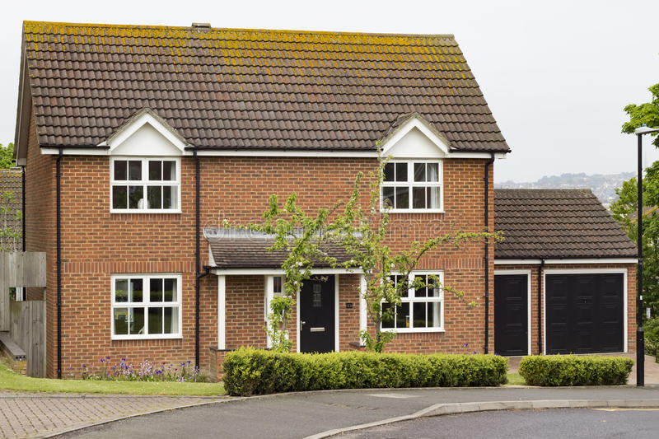
The shop
Stephen’s house
Activity:
Think about all of the things Stephen passes on his way home from the shop.
Can you draw these on the map in your pack and label them?
You might want to make your own map too and label some of the things you might see or meet.

Slide 6
Stephen meets lots of animals on his way back from the shops who all want different things from him.
Activity:
Look at the speech bubbles next to the animals Stephen meets. What do they say? Can you write sentences or words to show what they ask for?

Slide 7
When Stephen is on his way back from the shops he meets lots of interesting creatures. I wonder who was your favourite? I wonder what you would like to meet on your way home? It could be a dinosaur, or a mermaid, or a lion….. or anything you would like!
Activity:
I would like you to think about up to 3 creatures/animals you might meet on your way back from the shops. What did they want from you? What did you give them? Draw your creatures in the box and write some sentences to explain what happened when you met them.

